Slide 1
A
Motivation

Slide 2
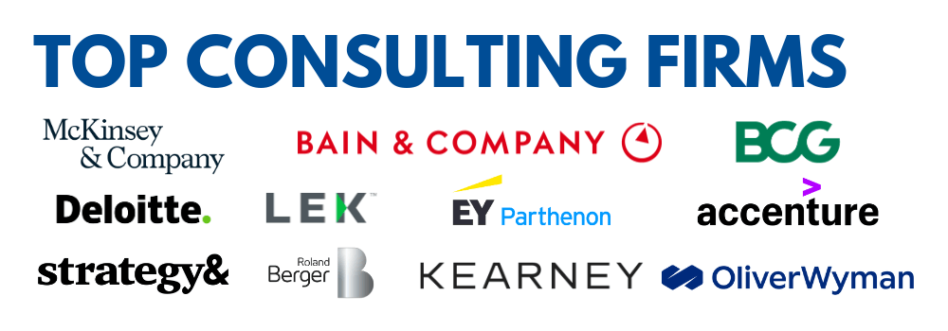

Why Consulting Case ChatBots?
Interviews are always NERVOUS!

Slide 3

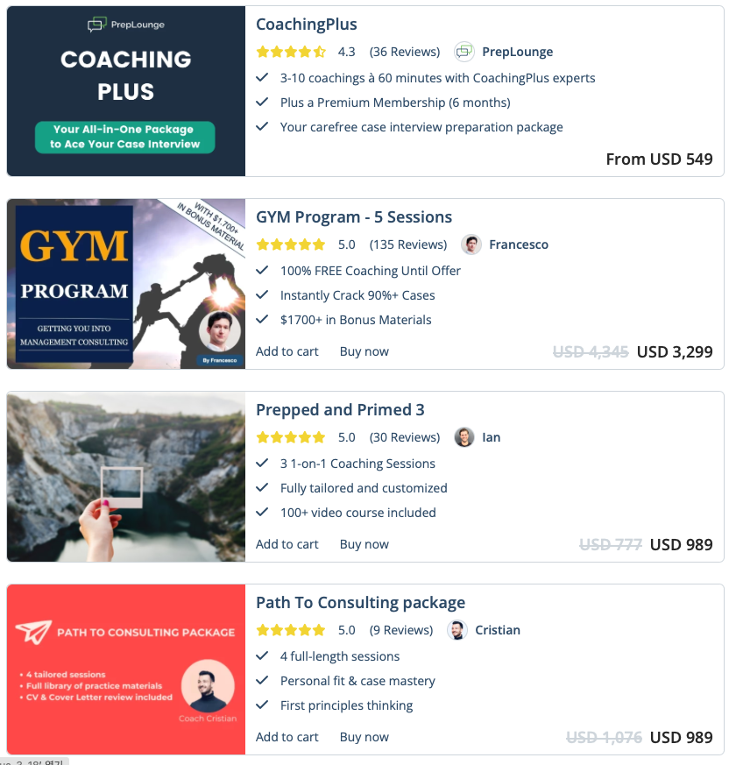
Gap in the Market
Current price of mock interviews are overly expensive
More than $2000 with a 50% discount!

Slide 4

Scope of the product
Specifically, Business consulting case interviews
Which provides interactive interviews of specific case studies
Requires knowledge of the field

Slide 5

Goal & Target Customers
Want to build an interactive chatbot that can practice mock interviews and provide evaluations and feedback
Target Customer: Job candidates preparing for business case interviews

Slide 6

Cacey the ChatBot:
An Interactive Business Consulting Interview Assistant
Team 7. Lindenau Tim / Nielsen Sigurd Frank Thorlund / Jihoon Han / Donghwa Kim / Jaehoon Hahm /

Slide 7
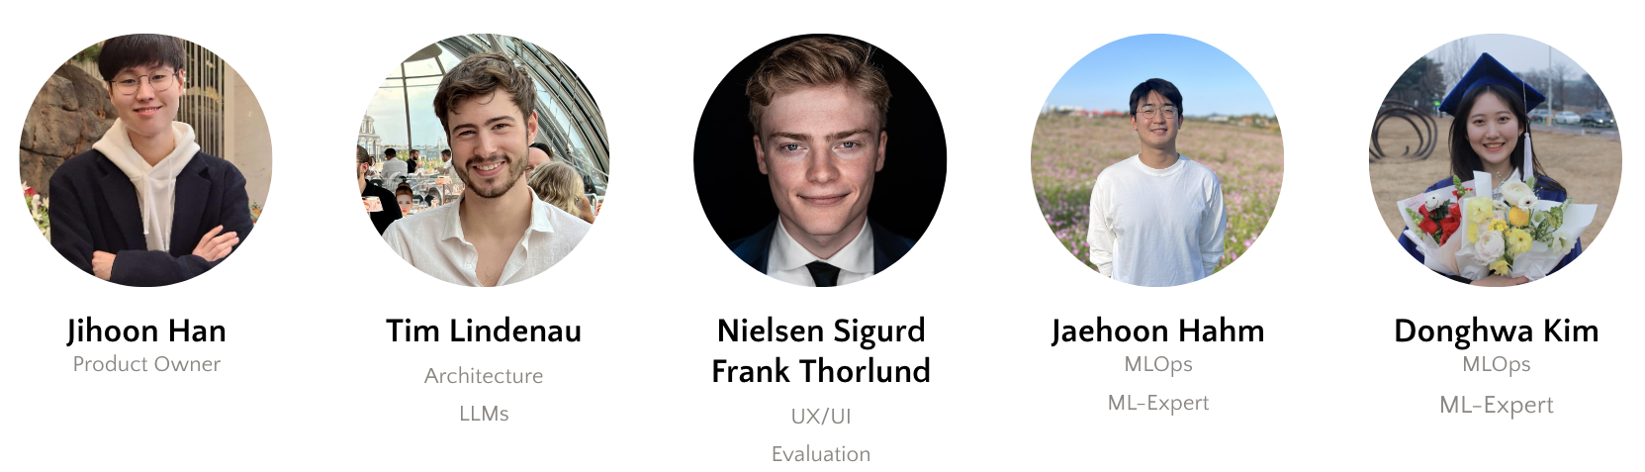
Members
Notes:
Jihoon: Cost prediction, Quality Assurance, Team Scheduling, Presentations
Tim: Designed architecture of the whole system. Implemented the chatbot system using various techniques such as state-machines.
Sigurd: Created the UI, and built the interview evaluation system with Donghwa
Jaehoon: Focused on the visual analysis components.
Donghwa: Worked on the visual analysis feedback and overall evaluation system with Sigurd.

Slide 8
B
Live Demo

Slide 9

Live Demo
Notes:
Show Dashboard
You can browse for cases
Right now two but our software can handle much more. It takes 30 minutes to add new case
Start one Case

Slide 10

C
Architecture
Notes:
Hello everyone I am Tim and I want to start my showing you the architecture of our product

Slide 11



Three Factors when Deciding for an Architecture
1. Moving Fast
2. Developer Experience
3. Costs
Similar Technologies in Frontend and Backend so everyone can participate everywhere
Full Typesafety and automatically generated Type hints to prevent Bugs and support Developers
Low Prices and Generous Free Tiers to cheaply scale to the first thousand customers
Notes:
First, I want to talk about the factors we considered when deciding for our architecture. For us there were three key factors.
The first one was to move fast, this especially meant that we were looking to use similar technologies throughout the whole project. In our example this was typescript both in the front and in the backend.
The second factor was a good developer experience. Again typescript was the natural choice here due to automatic typehints, furthermore we wanted typesafety between front, and backend, which we achieved by using TRPC instead of a Rest API.
Finally, costs are always a major factor to consider, so we decided for services that are cheap and offer generous free tiers to allow us to scale to the first thousand's customers completely for free.

Slide 12








Architecture Overview
NextJS – Fullstack Application
Frontend
Backend
React
Authentication
Database
Text-2-Speech
TRPC
Vision
Language Model
Tailwind
Notes:
The full architecture can now be seem in this diagram. For building our Application we decided to use the Framework NextJs. Within this framework the frontend code was written in React with Tailwind for consistent styling. Our Backend consist of 4 key components. Authentication for which we are using the service CLERK, Database where we are using MySQL hosted on Planet Scale. Computer Vision and the Chatbot Language Model part. Frontend and Backend are connected with TRPC instead of REST which guarantees typesafety and is just generally a better developer experience in my opinion
Finally, we had to build an external service for speech to text. This component is based on googles speech-to-text engine and is deployed via docker on google cloud. Out Website and Text-2-Speech are connected websockets.

Slide 13
D
Main Features
Notes:
Now after this more high-level overview we want to go more into detail on our four main features

Slide 14




4 Key Components For Successful Interview Training
1. Chatbot Interview
Partner
2. Speech To Text
3. Image Guided
Emotion Analysis
4. Case Evaluation
Notes:
As we can see here these features are the Chatbot, Speech to Text, Image Guided Emotion Analysis and finally Case Evaluation

Slide 15
4 Key Components For Successful Interview Training
1. Chatbot Interview
Partner
2. Text To Speech
3. Image Guided
Emotion Analysis
4. Case Evaluation
Notes:
Let me start with the Chatbot

Slide 16
Cases are Complex, You Cannot just use ChatGPT for the Whole Interview
Example Prompt Chatbot
“You are to take the role of an interviewer in a Case Interview for a Management Consulting Firm. …
The case is the following: A Company is trying to enter the market of ,…
One reference solution for the case could be the following:
Framework
Bucket 1: Market Attractiveness
…
…
Start the case now:”
Approach like this does not work well
ChatGPT struggles with long-term dependencies
ChatGPT has issues properly guiding to next structure points
High complexity in prompt tuning and missing control
Notes:
What we want to emphasize in this section is the complexity of actually bulding the chatbot. The naïve approach to solve our problem would probably be to just prompt ChatGPT once and then let it do all the work. This could look something like shown here on the left. Basically, we first tell it the situation, then we tell it about the case, give a reference solution and finally start the case.
At the beginning we experimented with an approach like this but it did not work well. The biggest issue was that ChatGPT struggled with the long-term dependencies within an interview and was not able to properly follow the flow of the interview from start to finish. Furthermore this approach was very involved when it came to prompt tuning and did not gave us enough control to influence how the case is completed.

Slide 17
Cases are Complex, You Cannot just use ChatGPT for the Whole Interview
Case Parsed into Structure
From solving more than 30 cases we know that each case follows a similar general structure
Question: Can we create a state-machine to follow this structure
Introduce special file format to parse arbitrary cases to state-machine
For each stage we can individually instruct ChatGPT
Provide additional information
Provide reference solution
Check whether section finished
Introduction
Framework
Question 1
Question 1a
Question 2
Question 1b
Conclusion
Notes:
Seeing that the trivial approach did not work, we then brainstormed for a better solution. Siggi and I both previously applied to consulting jobs, and we realized that all cases generally follow a similar structure. This gave us the idea, why not model the case in a graph like structure and create a state-machine to follow the case. One example how such a graph could then look like is shown here on the right.
Practically all cases start with an introduction part and a framework part. After this we typically have around 3 questions. Sometimes these questions must be worked through sequentially but sometimes the order is not important. For example, here we have three Questions 1a and 1b which must be completed sequentially, and Question 2 which can either be completed before or after question 1. Finally, the case ends with a conclusion.
So what is not the big advantage of our approach. Due to using a state-machine, ChatGPT must no longer remember the full state of the interview, thus solving the issue of long-term dependency. Furthermore, our approach allows us to individually instruct ChatGPT for each section, allowing us to provide further information when necessary.

Slide 18
A State-Machine Helps to Reinstruct ChatGPT for Specific Sections
Run Section
Introduce Section
Transition
Read Candidate Input
Provide Section Information to Chatbot
Task
Reference Solution
Additional Information
Definition of Done
Ask candidate where to continue
Check against possible options
Transition to next section
Section Complete?
Yes
No
Respond to Candidate
Notes:
A more detailed look as how the state machine guides ChatGPT through each section is shown on this slide. Each Section first starts with the Introduction. This is the point where we instruct ChatGPT with extra information such as the specific task, a reference solution, additional information and a definition of done.
Afterwards we then run the section. In a loop we first read the candidate input. ChatGPT is then tasked to evaluate if the section is completed. If it is not, we generate a response and wait for the next input. If the section is completed, we then initiate the transition. Here the candidate is first asked where he would like to continue. ChatGPT takes this input and compares it with the options from our case graph. If the candidate chose a suitable option, we will move there. Otherwise ChatGPT decides for an option which matches the flow of the interview and we continue there.

Slide 19
4 Key Components For Successful Interview Training
1. Chatbot Interview
Partner
2. Speech To Text
3. Image Guided
Emotion Analysis
4. Case Evaluation
Notes:
Now let's continue with the second key component Speech To Text

Slide 20
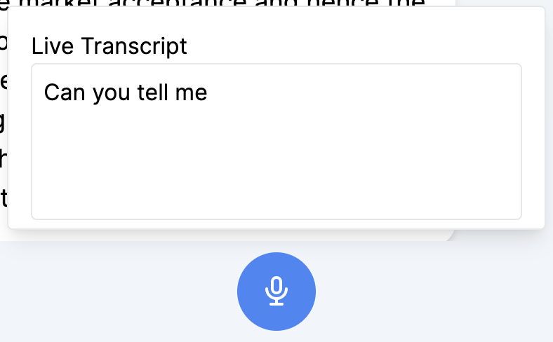
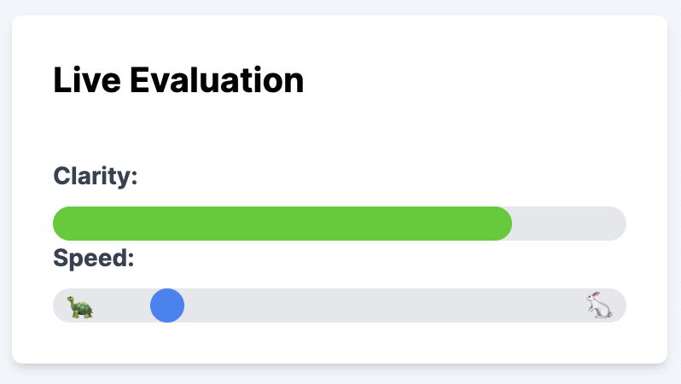
Speech To Text Provides an Additional Modality To More Truthfully Imitate Interview Situation
Motivation why Speech
Closer to real interview
Analyze Speed, Clarity, (Sentiment)
Our Solution:
Decision for Google Speech due to real-time streaming capabilities
Live Transcribe Text
Compute Speed and Clarity Scores
Challenge:
Google Speech requires File System
File System not available in Browser
Build additional service to connect Browser and Google Speech
Live Transcription
Live Evaluation
Notes:
The first question is of course, why did we even bother with implementing Speech-2-Text. For us the motivation was twofold. First, we strongly believe that a text input is closer to the real interview situation and thus a more suitable modality. Additionally, speech input allows us to gather more datapoints to holistically evaluate the candidate performance such as his clarity and whether he is speaking too fast.
As previously indicated when it came to the question of implementing speech-2-text we decided to use the service from google. We decided for this service because it allowed for stream-based real-time transcription. Furthermore, it provided additional metadata that allowed us to easily compute speed and clarity metrics.
One Challenge, however, significantly increased the difficulty of implementing speech-to-text. This challenge was that google speech require a local file-system which is not available on client devices on the browser. To overcome this issue, we implemented an additional service to stream our response from the client to google cloud. The client connects to this service via websockets, and we deployed the service on google cloud run using Docker

Slide 21
4 Key Components For Successful Interview Training
1. Chatbot Interview
Partner
2. Text To Speech
3. Video Guided
Emotion Analysis
4. Case Evaluation

Slide 22
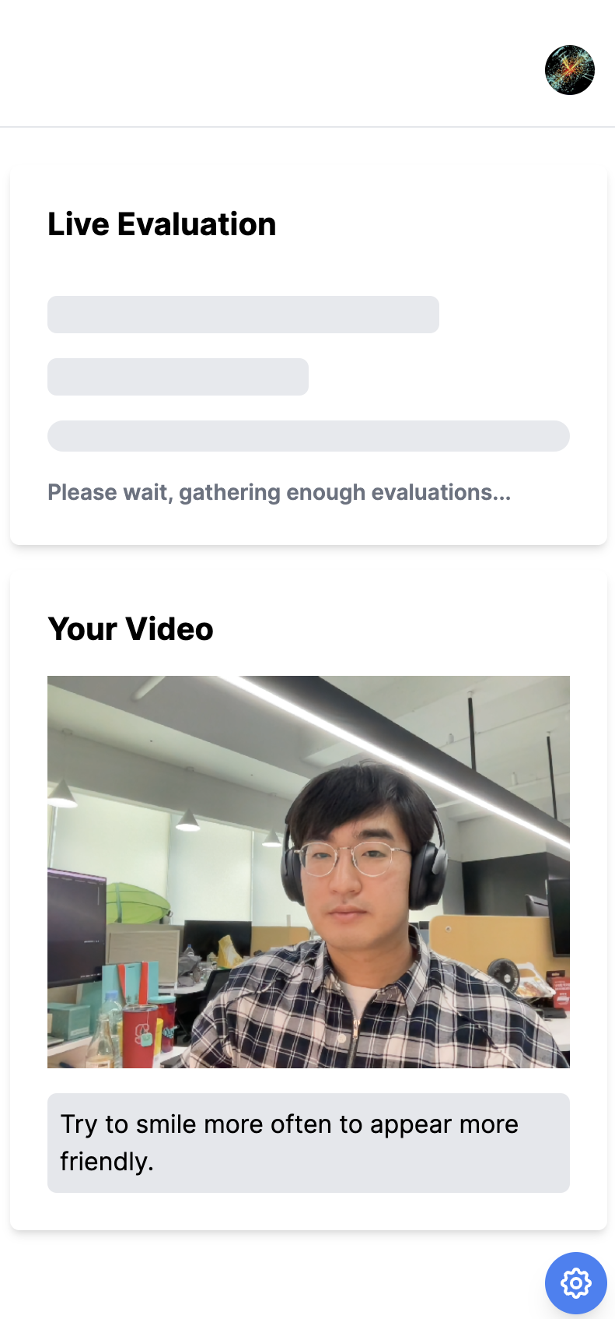
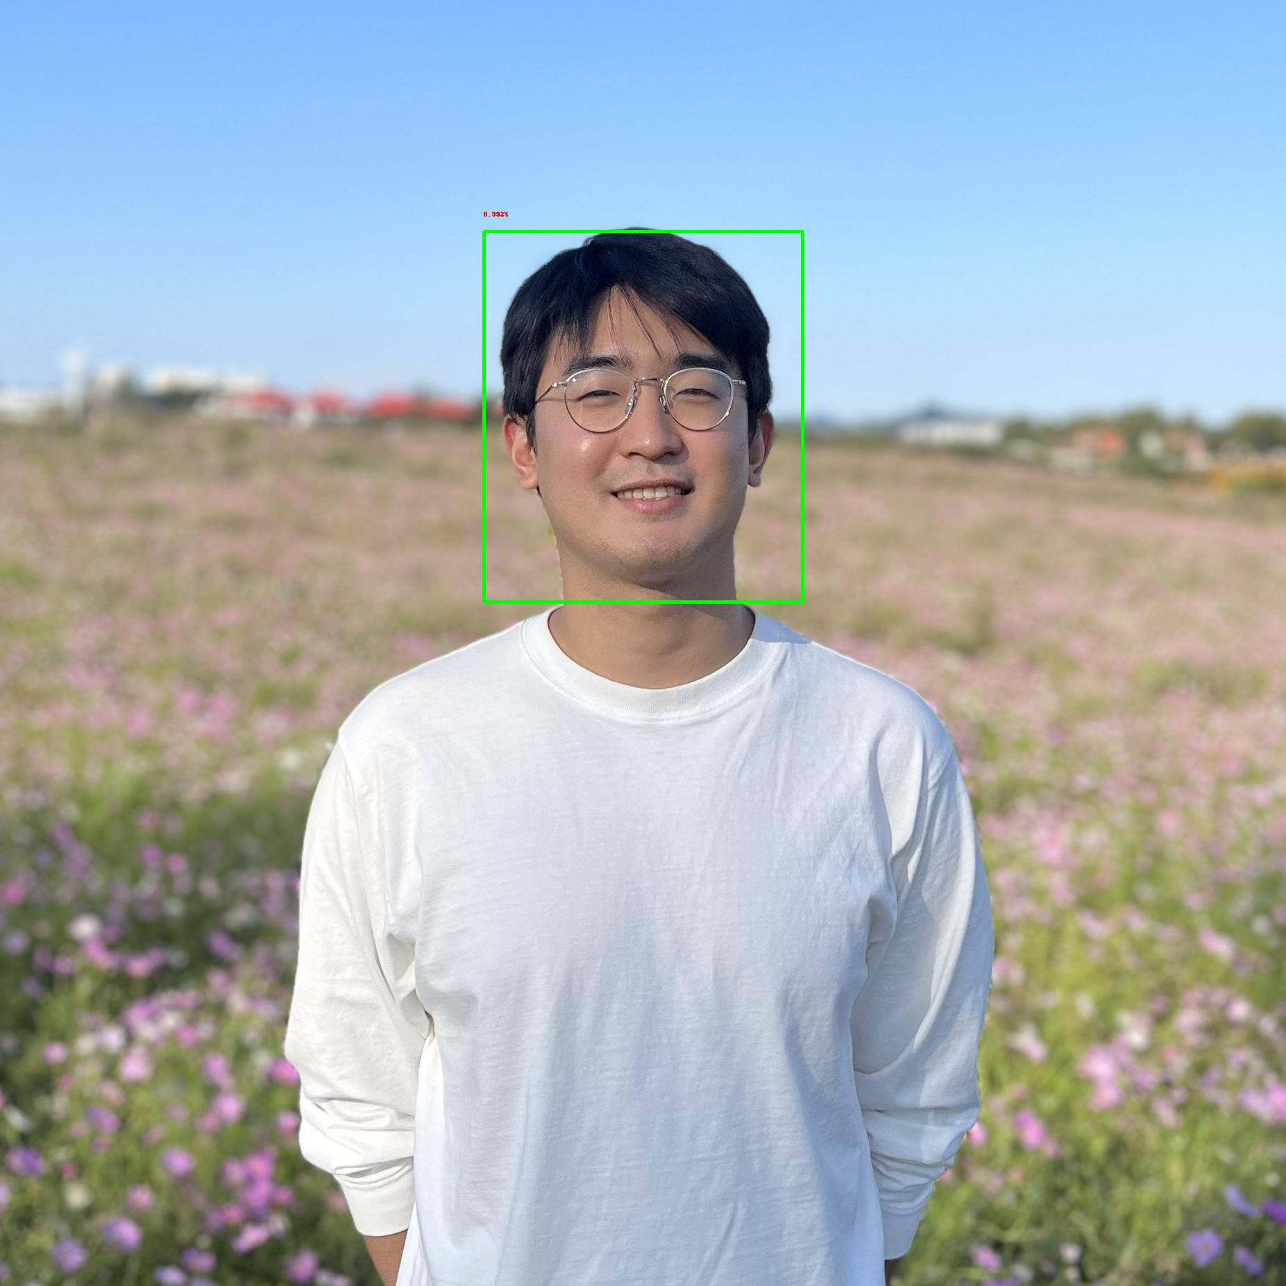
Emotion Analysis (Video)
Likelihood | Evaluation Score
VERY_LIKELY | 4
LIKELY | 3
POSSIBLE | 2
UNLIKELY | 1
VERY_UNLIKELY | 0
Possible Solutions for Emotion Analysis:
Pretrained machine learning model for emotion analysis
Google Cloud Platform: Video Intelligence API (expensive)
Google Cloud Platform: Vision AI, ImageAnnotator (convenient!) → our chosen solution
Method
Record frame every 10s for the input video.
Detect faces, analyze 4 emotions in likelihood scores.
Save it into emotion likelihood DB for every frame
Pass the average score to LLM for sentiment analysis

Slide 23
4 Key Components For Successful Interview Training
1. Chatbot Interview
Partner
2. Text To Speech
3. Image Guided
Emotion Analysis
4. Case Evaluation

Slide 24



Evaluating Cases Generates Value For Users
Purpose
Challenges
Questions
Evaluate candidate performance upon completing a case
Value in feedback and pointers on how to improve
Evaluations are subjective judgements made on expert intuitions
Each case may be evaluated differently
No data available
How can we introduce expert intuition in case evaluations?
How do we make the framework general enough to work with all cases?

Slide 25
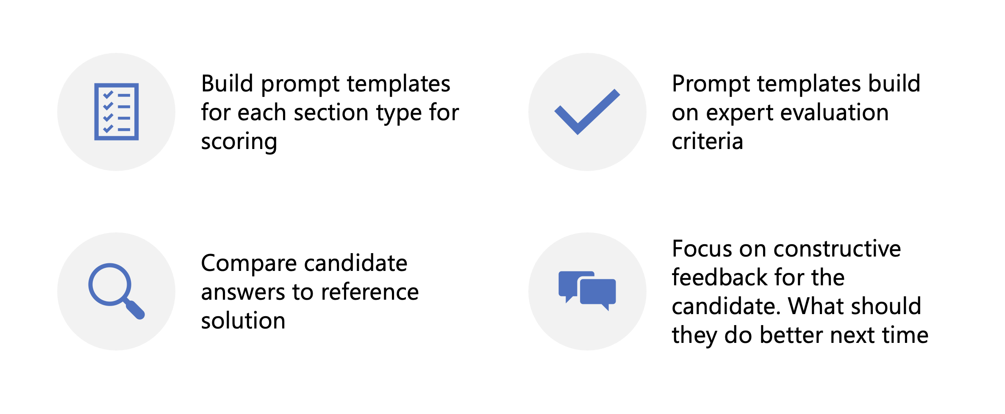
Prompt Templates Build On Expert Evaluation Criteria Provide General Framework For Feedback

Slide 26
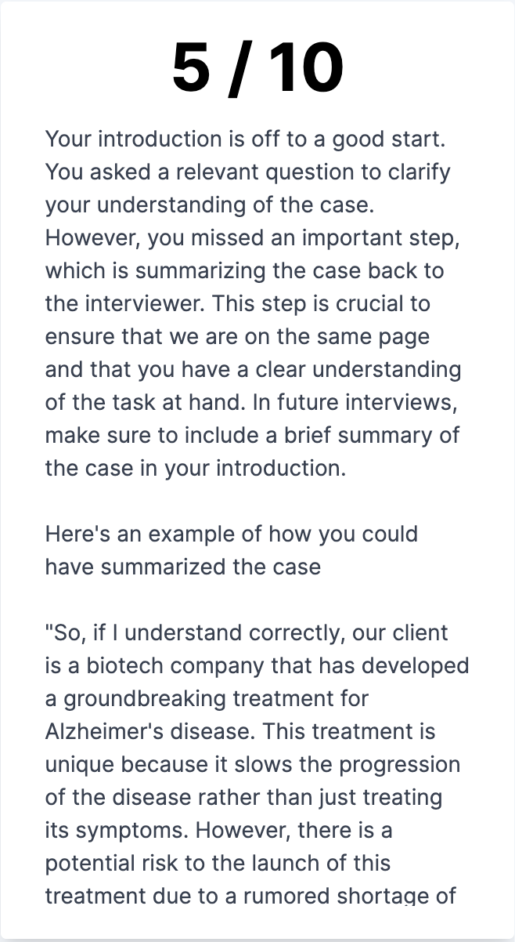
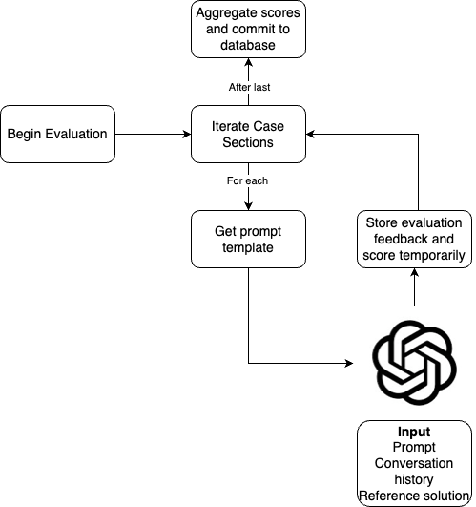
Case Evaluation

Slide 27
E
Business Model

Slide 28
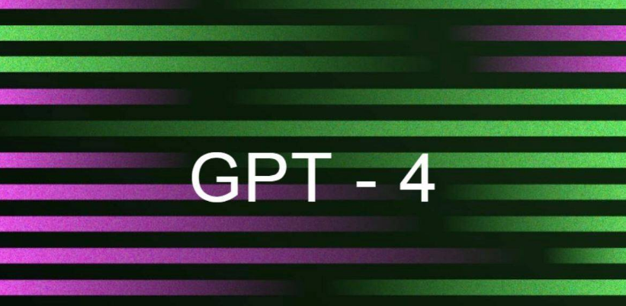
Conducting one Interview Costs Around $1
Tokens Per Interview:
From Experience we know each Interview has:
2500 Output Tokens
30 000 Input Tokens
Cost Per Token (GPT-4.5 Turbo):
Input: $0.01 / 1K tokens
Output: $0.03 / 1K tokens
Cost Per Interview:
$0.01*2.5 + $0.03 * 30 = $0.93¹
¹Negligibe extra costs from hosting and additional services
Each interview takes about 25 minutes
About 5000 words per interview
GPT-4: $0.12 per 1K tokens
Expected cost: $15 for 20 interviews, $15 for evaluations. Total: $30/ month
Interview 5000 Words (Candidate and Interviewer)
In experience
- 2000 Output Tokens -> 0.12*2 = 0.24
- 20 000 Input Tokens (from experience) -> 0.06*20 = 1.2

Slide 29
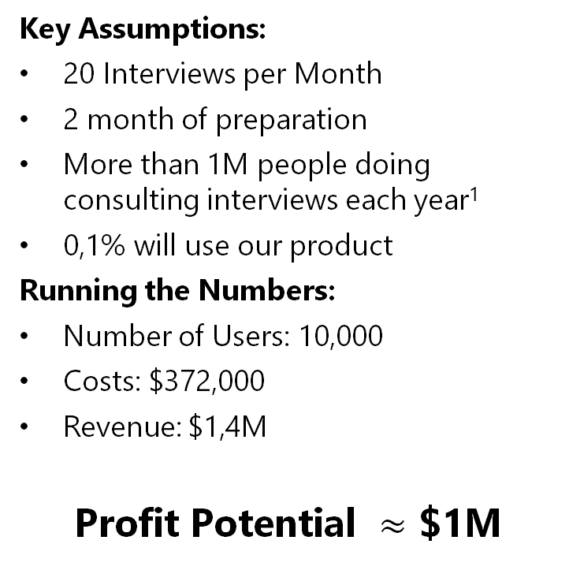
Our Business Model – Subscription for Just $70 / Month Much Cheaper Than Competition
Our Service Available for Just $70
a Month
Much Cheaper Than The Competition
Key Assumptions:
20 Interviews per Month
2 month of preparation
More than 1M people doing consulting interviews each year¹
0,1% will use our product
Running the Numbers:
Number of Users: 10,000
Costs: $372,000
Revenue: $1,4M
Profit Potential $≈$ $1M
¹Based on Assumption that McKinsey has 1M applicants per year

Slide 30
F
Execution
Notes:
I’m donghwa from Team 7
I’m gonna introduce our execution part.

Slide 31


Two Factors For Effective Team Organization
Factor 1 - Weekly Meetings
Factor 2 - Effective Tooling
Discuss last week's results
Decide next week’s priorities
Split parts based on skills and knowledge
GitHub (Code)
Shared Figma (Design)
Draw.IO (Diagrams & Documentation)
Kakao Talk
Notes:
There are two factors that make our team effective.
The first factor was weekly meetings In the weekly meeting, we discussed the results from the last week, decided the priorities on next week and split the parts based on individual skills and knowledge.
The second factor was effective tooling. We utilized a lot of tools for our cooperation. For example, github for code, shared figma for design, drawio for diagram, and lastly kakaotalk for our communication.

Slide 32
Project Timeline
 | 10/16 | 10/26 | 11/02 | 11/09 | 11/16 | 11/20 | 11/23 | 11/30 | 12/6 | 12/8
Ideation & Scoping | ✔
Prompt Engineering | ✔ | ✔
Architecture Design |  | ✔ | ✔
Develop Fundamental Components |  |  | ✔ | ✔ | ✔
Develop UI (Frontend) |  |  |  | ✔ | ✔ | ✔
Connect All Components Together |  |  |  |  |  |  | ✔
Refine & Test |  |  |  |  |  |  |  | ✔ | ✔
Final Presentation |  |  |  |  |  |  |  |  |  | ✔
Have a Look At Our Timeline in the Appendix
Notes:
This is our project timeline.
I should skip it because of the time limit. please have a look at it in the appendix.

Slide 33


Three Key Learnings Throughout the Project
Ideation
Proof of Concept
Architecture
Good thing to spend time on searching topic and competitor solutions
Verifying that product idea is sound and can provide value
Verify functionality in first draft produced in Python with simple CLI application
Fail fast and ensure that the solution is feasible
Choose architecture based on the skills of the team members.
Choice of coding language is important to allow all members of the team to contribute to code base.
Learning while doing requires more effort.
Notes:
There were three component that we learned throughout the project.
First of all, in the ideation process, it's always good thing to spend time on searching topic and competitor solutions. Also we learned that it is important to verify that our product idea is sound and provide values.
Second, in the proof of concept, we should have verified functionality in the first draft. So we produced them in python code with simple command line interface application.
We could fail fast and ensured that the solution is feasible.
The last one is the architecture. we chose the architecture based on the skills of our team members. The choice of the coding is also critical to allow all members to contribute to the code base. Of course, learning while doing requires more effort.

Slide 34
G
Future Work
Notes:
This is the last part, Future work.

Slide 35

Three Ideas for Future Improvements
1. Improve Chat Quality
2. Add More Cases
3. Improve Evaluation
Introduce second LLM to evaluate responses before showing to Candidate¹
More cases can easily be added to the library. Manual labor of 30 minutes required per case
Gather more datapoints for evaluation. Examples include Sentiment, Tone, and Pose
¹Additional Information provided in the Appendix
Notes:
I think we have three ideas to improve our product.
First, we can improve the chat quality by introducing second LLM to evaluate responses before showing to the candidate.
Secondly, we can add more cases. We only have two cases yet but we can manually add to the library. It takes about 30 mins per case.
Lastly, with more datapoints we can improve the evaluation results, like including sentiment, tones and poses.

Slide 36
THANK YOU

Slide 37
G
Appendix

Slide 38
Filter and Improve Chatbot Responses
Safety Filter Architecture
The Challenge
In the state-machine, chatbot required to provide output in well-defined format
Example: Did The Candidate Finish This Section → Answer: True/False
Our Solution:
Custom Safety Filters to match patterns and reprompt the model
Future Work:
Safety Filter only checks semantics but not content
Output quality can be improved by having a second model evaluate the output
Chatbot Output
Output Matches Format
?
Reprompt
Continue
Slide Added by Tim Lindenau after Deep Dive

Slide 39




DevOps – Easy Deployment, Automatic Scaling and Separation between Production and Development Environment
1. Vercel
2. Google Cloud
Deploy Next.Js application on serverless infrastructure
Master branch automatically published
Other branches published to private preview builds
Cloud Run to deploy containerized speech-to-text service
Vision API
Vertex AI language models
3. Planetscale
4. Clerk
Automatically scaling database
Production and development environment separated by environment variables
Git-like branching feature to test-features more easily
Service to guarantee stable and secure authentication
Production and development environment separated
Secures application and speech-2-text
Slide Added by Tim Lindenau after Deep Dive

Slide 40
Project timeline
 | 10/16 | 10/26 | 11/02 | 11/09 | 11/16 | 11/20 | 11/23 | 11/30 | 12/6 | 12/8
Ideation & Scoping | ✔
Prompt Engineering | ✔ | ✔
Architecture Design |  | ✔ | ✔
Develop Fundamental Components |  |  | ✔ | ✔ | ✔
Develop UI (Frontend) |  |  |  | ✔ | ✔ | ✔
Connect All Components Together |  |  |  |  |  |  | ✔
Refine & Test |  |  |  |  |  |  |  | ✔ | ✔
Final Presentation |  |  |  |  |  |  |  |  |  | ✔

